Slide 1
nodeMCU 2
WiFi 2

Slide 2
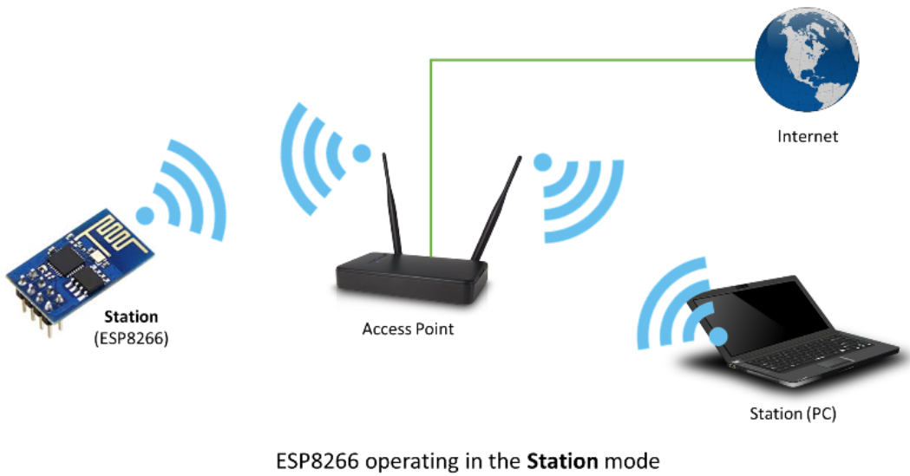
Esp8266 WiFi mode(1)
Station (STA) 모드는 엑세스포인트(AP : access point )에 의하여 동작하는 WiFi 네트워크에 ESP8266을 연결할 때 사용한다.

Slide 3
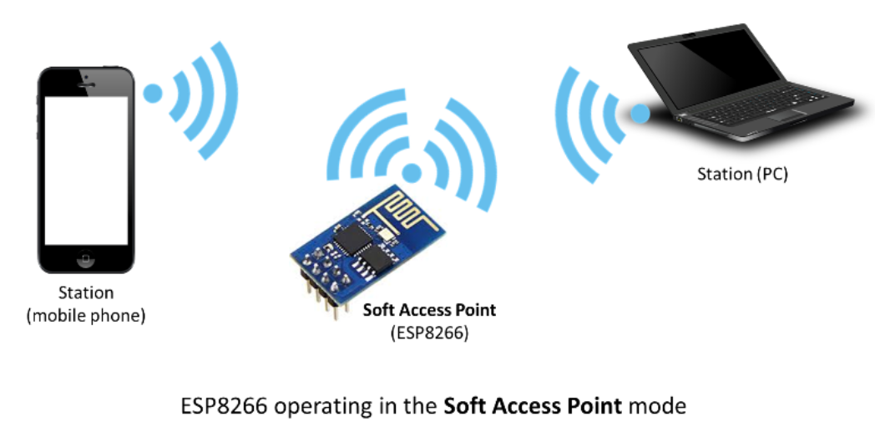
Esp8266 WiFi mode(2)
access point (AP) : 다른 스테이션들이 Wi-Fi 망에 접속할 수 있게 해주는 장치로 유선 네트워크로 연결을 제공한다. ESP8266은 유선 네크워크의 인터페이스를 제외하고 이와 유사한 기능을 제공한다. 이와같은 동작을 소프트 엑세스포인트 (soft-AP)라 부른다. 소프트 엑세스포인트에 접속 가능한 최대 스테이션은 5개이다

Slide 4
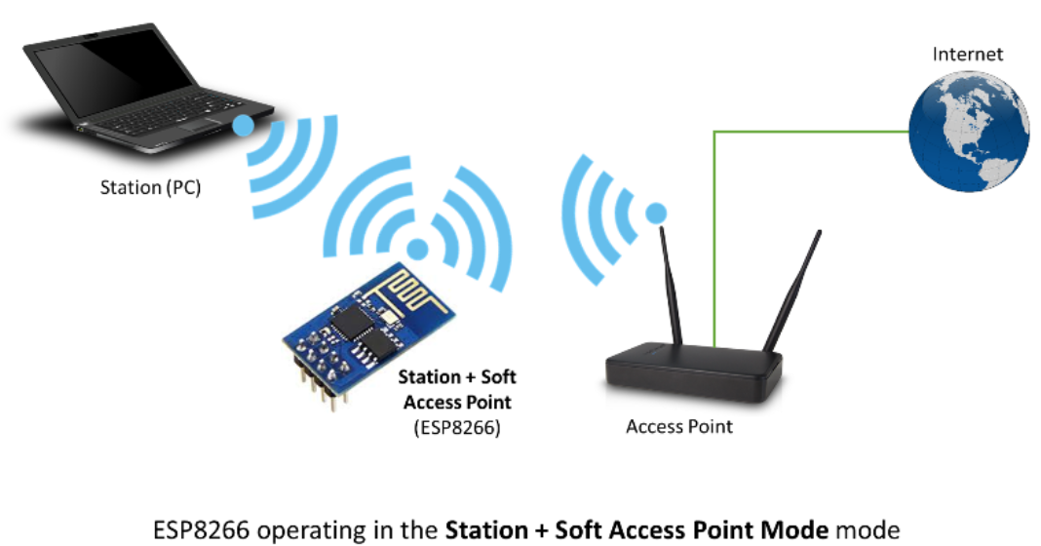
Esp8266 WiFi mode(3)
ESP 는 소프트 엑세스포인트와 스테이션 모드에서 동시에 동작 가능하다. 이를 이용하여 메시 네트워크(mesh network)의 노드로 동작할 수 있다.

Slide 5
ESP8266WIFI/UDP 예제 (1)
#include <ESP8266WiFi.h>
#include <WiFiUdp.h>
#ifndef STASSID
#define STASSID “********“ // SSID
#define STAPSK “***********“ // Password
#endif
unsigned int localPort = 8888; // local port to listen on
// buffers for receiving and sending data
char packetBuffer[UDP_TX_PACKET_MAX_SIZE + 1]; //buffer to hold incoming packet, 8192+1
char ReplyBuffer[] = "acknowledged\r\n"; // a string to send back
WiFiUDP Udp;
void setup() {
Serial.begin(115200);
WiFi.mode(WIFI_STA);
WiFi.begin(STASSID, STAPSK);
while (WiFi.status() != WL_CONNECTED) {
Serial.print('.');
delay(500);
}
Serial.print("\nConnected! IP address: ");
Serial.println(WiFi.localIP());
Serial.printf("UDP server on port %d\n", localPort);
Udp.begin(localPort);
}

Slide 6
ESP8266WIFI/UDP 예제 (2)
void loop() {
// if there's data available, read a packet
int packetSize = Udp.parsePacket();
if (packetSize) {
Serial.printf("Received packet of size %d from %s:%d\n (to %s:%d, free heap = %d B)\n",
packetSize,
Udp.remoteIP().toString().c_str(), Udp.remotePort(),
Udp.destinationIP().toString().c_str(), Udp.localPort(),
ESP.getFreeHeap());
// read the packet into packetBufffer
int n = Udp.read(packetBuffer, UDP_TX_PACKET_MAX_SIZE);
packetBuffer[n] = 0;
Serial.println("Contents:");
Serial.println(packetBuffer);
// send a reply, to the IP address and port that sent us the packet we received
Udp.beginPacket(Udp.remoteIP(), Udp.remotePort());
Udp.write(ReplyBuffer);
Udp.endPacket();
}
}

Slide 7
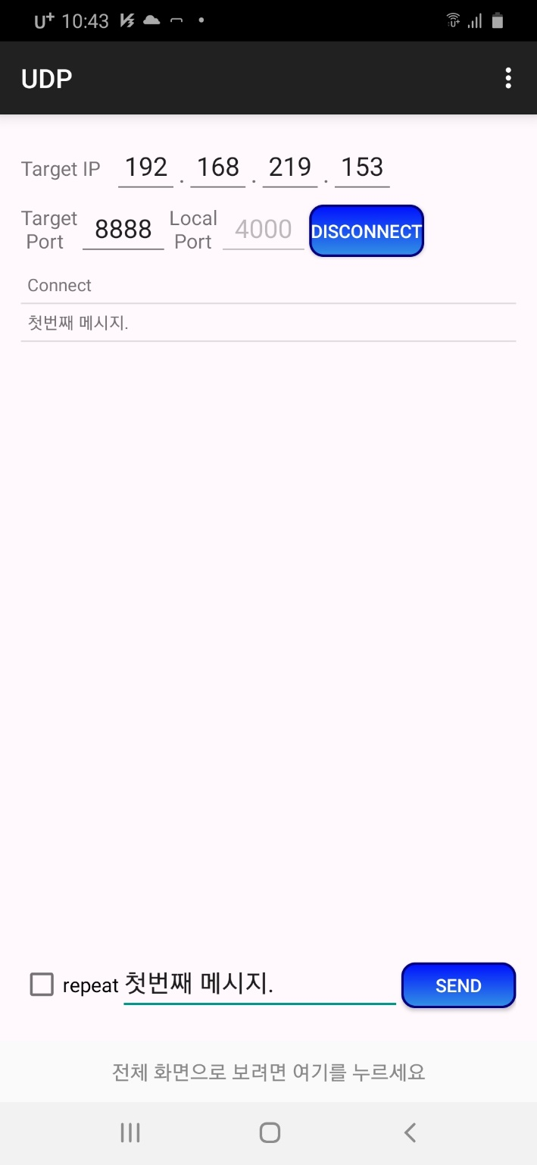
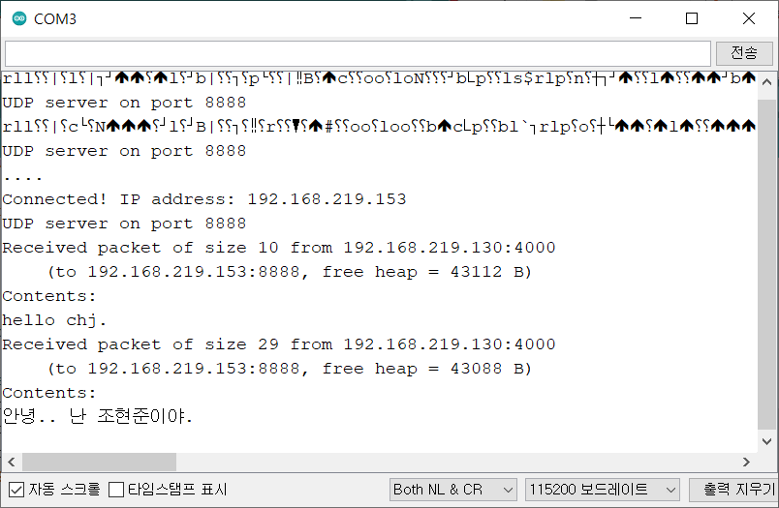
실행화면 (시리얼 모니터)
스마트폰 앱 TCP/UDP TEST TOOL 화면

Slide 8
WiFiClientBasic 예제 (tcp 연결) (1)
void setup() {
Serial.begin(115200);
// We start by connecting to a WiFi network
WiFi.mode(WIFI_STA);
WiFiMulti.addAP(ssid, password); // wifi 하나를 포함
// 다수의 wifi를 포함할 수 있음
Serial.println();
Serial.println();
Serial.print("Wait for WiFi... ");
// 가장 신호가 강한 wifi에 접속됨
while (WiFiMulti.run() != WL_CONNECTED) {
Serial.print(".");
delay(500);
}
Serial.println("");
Serial.println("WiFi connected");
Serial.println("IP address: ");
Serial.println(WiFi.localIP());
delay(500);
}
#include <ESP8266WiFi.h>
#include <ESP8266WiFiMulti.h> // 다수의 wifi 존에 접속 가능할 때
#ifndef STASSID
#define STASSID “cse506cse506"
#define STAPSK “cse506cse506"
#endif
const char* ssid = STASSID;
const char* password = STAPSK;
const char* host = "192.168.1.1";
const uint16_t port = 3000;
ESP8266WiFiMulti WiFiMulti;

Slide 9
WiFiClientBasic 예제 (tcp 연결) (2)
void loop() {
Serial.print("connecting to ");
Serial.print(host);
Serial.print(':');
Serial.println(port);
/* Use WiFiClient class to create TCP connections */
WiFiClient client;
if (!client.connect(host, port)) {
Serial.println("connection failed");
Serial.println("wait 5 sec...");
delay(5000);
return;
}
// This will send the request to the server
client.println("hello from ESP8266");
//read back one line from server
Serial.println("receiving from remote server");
String line = client.readStringUntil('\r');
Serial.println(line);
Serial.println("closing connection");
client.stop();
Serial.println("wait 5 sec...");
delay(5000);
}

Slide 10
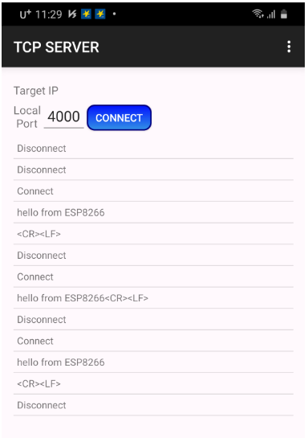
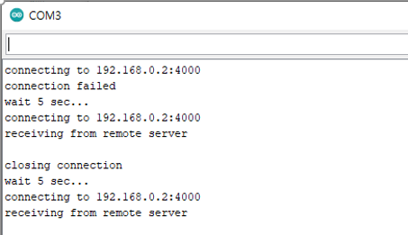
실행화면
스마트폰 앱 TCP/UDP TEST TOOL 화면

Slide 11
TCP Server 예 (1)
pinMode(LED, OUTPUT); // 램프 포트를 출력으로 설정
WiFi.begin(ssid, pass); // TCPIP 를 시작
while (WiFi.status() != WL_CONNECTED) { // 연결 시까지 대기
Serial.print(".");
delay(200); // 20밀리초 지연을 진행합니다
}
Serial.print("Point : ");
Serial.println(ssid); // 무선네트워크 ID
Serial.println("Alarm IP : ");
Serial.print(WiFi.localIP()); // ex) 192.168.0.28
delay(200);
server.begin(); // TCP 서버 시작
}
#include <ESP8266WiFi.h>
#define PORT 4000
WiFiClient client; // 클라이언트 대리자를 선언
WiFiServer server(PORT);
String dataClient;
const char* ssid = “cse506cse506”;
const char* pass = “cse506cse506”;
#define LED 2 // GPIO 2
void setup() {
Serial.begin(115200); // 통신속도를 설정
delay(200);
Serial.println("\ntest TCPIP "); // 제목
Serial.print("Port : ");
Serial.println(PORT);

Slide 12
TCP Server 예 (2)
void loop() {
while(!client.connected()) { // TCPIP 가 연결 안된 상태면?
client = server.available();
}
while (client.connected()) { // TCPIP 가 연결된 상태면?
if (client.available()) {
char data = client.read(); // 수신버퍼에서 데이터 읽기
dataClient += data; // 수신 문자 추가
if (dataClient.equals("on")) { // 램프 켜기(ON)면?
digitalWrite(LED, HIGH); // 램프 켜기(ON)
Serial.println("on");
dataClient = ""; // 수신버퍼 초기화
}
if (dataClient.equals("off")) { // 램프 끄기(OFF)면?
digitalWrite(LED, LOW); // 램프 끄기(OFF)
Serial.println("off");
dataClient = ""; // 수신버퍼 초기화
}
}
}
}

Slide 13
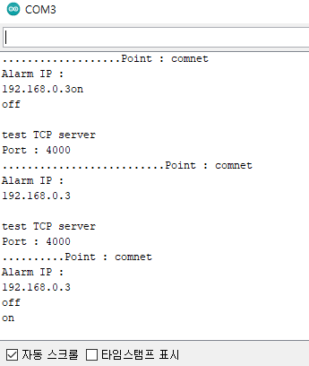
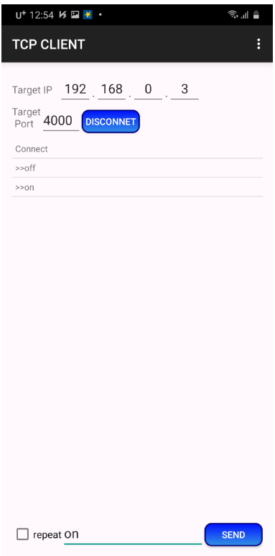
실행결과 (시리얼모니터와 스마트폰 앱 화면)

Slide 14
WiFiAccessPoint 예제
#include <ESP8266WiFi.h>
#include <WiFiClient.h>
#include <ESP8266WebServer.h>
#ifndef APSSID
#define APSSID "ESPap"
#define APPSK "12341234"
#endif
/* Set these to your desired credentials. */
const char *ssid = APSSID;
const char *password = APPSK;
ESP8266WebServer server(80);
/* Just a little test message. Go to http://192.168.4.1 in a web browser
connected to this access point to see it.
*/
void handleRoot() {
server.send(200, "text/html", "<h1>You are connected !!</h1>");
}
void setup() {
delay(1000);
Serial.begin(115200);
Serial.println();
Serial.print("Configuring access point...");
/* You can remove the password parameter if you want the AP to be open. */
WiFi.softAP(ssid, password);
IPAddress myIP = WiFi.softAPIP();
Serial.print("AP IP address: ");
Serial.println(myIP);
server.on("/", handleRoot);
server.begin();
Serial.println("HTTP server started");
}
void loop() {
server.handleClient();
}

Slide 15
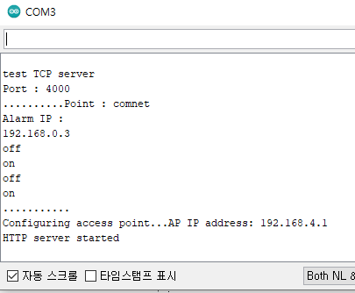
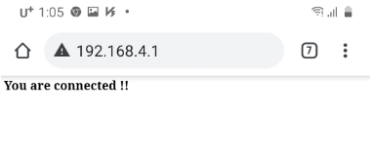
실행결과(시리얼모니터와 크롬 앱)

Slide 16
HelloServer (1)
void handleRoot() {
digitalWrite(led, 1);
server.send(200, "text/plain", "<h1>hello from esp8266!</h1>");
digitalWrite(led, 0);
}
void handleNotFound() {
digitalWrite(led, 1);
String message = "File Not Found\n\n";
message += "URI: ";
message += server.uri();
message += "\nMethod: ";
message += (server.method() == HTTP_GET) ? "GET" : "POST";
message += "\nArguments: ";
message += server.args();
message += "\n";
for (uint8_t i = 0; i < server.args(); i++) {
message += " " + server.argName(i) + ": " + server.arg(i) + "\n";
}
server.send(404, "text/plain", message);
digitalWrite(led, 0);
}
#include <ESP8266WiFi.h>
#include <WiFiClient.h>
#include <ESP8266WebServer.h>
#include <ESP8266mDNS.h>
#ifndef STASSID
#define STASSID “******"
#define STAPSK “**********"
#endif
const char* ssid = STASSID;
const char* password = STAPSK;
ESP8266WebServer server(80);
const int led = 13;

Slide 17
HelloServer (2)
if (MDNS.begin("esp8266")) {
Serial.println("MDNS responder started");
}
server.on("/", handleRoot);
server.on("/inline", []() {
server.send(200, "text/plain", "this works as well");
});
server.onNotFound(handleNotFound);
server.begin();
Serial.println("HTTP server started");
}
void loop(void) {
server.handleClient();
MDNS.update();
}
void setup(void) {
pinMode(led, OUTPUT);
digitalWrite(led, 0);
Serial.begin(115200);
WiFi.mode(WIFI_STA);
WiFi.begin(ssid, password);
Serial.println("");
// Wait for connection
while (WiFi.status() != WL_CONNECTED) {
delay(500);
Serial.print(".");
}
Serial.println("");
Serial.print("Connected to ");
Serial.println(ssid);
Serial.print("IP address: ");
Serial.println(WiFi.localIP());

Slide 18
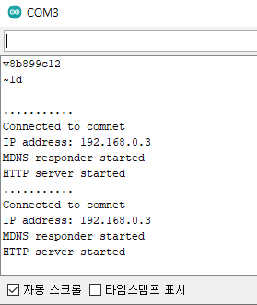
실행결과(시리얼모니터)

Slide 19
mDNS
mDNS는 멀티 캐스트 DNS
ESP8266과 같은 장치가 숫자 IP 주소가 아닌 DNS 스타일 시스템 (URL)을 사용할 수 있도록 하는 시스템
mDNS는 esp8266.local 또는 http://esp8266.local 같이 .local 접미사가 있는 URL을 사용
사용 예)
#include <ESP8266mDNS.h>;
if (!MDNS.begin("esp8266")) {
Serial.println("Error setting up MDNS responder!");
}
else { Serial.println("mDNS responder started"); }

Slide 20
HelloServerSecure 예제 (1)
#include <ESP8266WiFi.h>
#include <WiFiClient.h>
#include <ESP8266WebServerSecure.h>
#include <ESP8266mDNS.h>
#ifndef STASSID
#define STASSID “********"
#define STAPSK “*********"
#endif
const char* ssid = STASSID;
const char* password = STAPSK;
ESP8266WebServerSecure server(443);

Slide 21
HelloServerSecure 예제 (2)
// And so is the key. These could also be in DRAM
static const uint8_t rsakey[] PROGMEM = {
0x30, 0x82, 0x01, 0x3a, 0x02, 0x01, 0x00, 0x02, 0x41, 0x00, 0xc6, 0x72,
0x6c, 0x12, 0xe1, 0x20, 0x4d, 0x10, 0x0c, 0xf7, 0x3a, 0x2a, 0x5a, 0x49,
0xe2, 0x2d, 0xc9, 0x7a, 0x63, 0x1d, 0xef, 0xc6, 0xbb, 0xa3, 0xd6, 0x6f,
0x59, 0xcb, 0xd5, 0xf6, 0xbe, 0x34, 0x83, 0x33, 0x50, 0x80, 0xec, 0x49,
0x63, 0xbf, 0xee, 0x59, 0x94, 0x67, 0x8b, 0x8d, 0x81, 0x85, 0x23, 0x24,
0x06, 0x52, 0x76, 0x55, 0x9d, 0x18, 0x09, 0xb3, 0x3c, 0x10, 0x40, 0x05,
0x01, 0xf3, 0x02, 0x03, 0x01, 0x00, 0x01, 0x02, 0x40, 0x35, 0x0b, 0x74,
0xd3, 0xff, 0x15, 0x51, 0x44, 0x0f, 0x13, 0x2e, 0x9b, 0x0f, 0x93, 0x5c,
0x3f, 0xfc, 0xf1, 0x17, 0xf9, 0x72, 0x94, 0x5e, 0xa7, 0xc6, 0xb3, 0xf0,
0xfe, 0xc9, 0x6c, 0xb1, 0x1e, 0x83, 0xb3, 0xc6, 0x45, 0x3a, 0x25, 0x60,
0x7c, 0x3d, 0x92, 0x7d, 0x53, 0xec, 0x49, 0x8d, 0xb5, 0x45, 0x10, 0x99,
0x9b, 0xc6, 0x22, 0x3a, 0x68, 0xc7, 0x13, 0x4e, 0xb6, 0x04, 0x61, 0x21,
0x01, 0x02, 0x21, 0x00, 0xea, 0x8c, 0x21, 0xd4, 0x7f, 0x3f, 0xb6, 0x91,
0xfa, 0xf8, 0xb9, 0x2d, 0xcb, 0x36, 0x36, 0x02, 0x5f, 0xf0, 0x0c, 0x6e,
0x87, 0xaa, 0x5c, 0x14, 0xf6, 0x56, 0x8e, 0x12, 0x92, 0x25, 0xde, 0xb3,
0x02, 0x21, 0x00, 0xd8, 0x99, 0x01, 0xf1, 0x04, 0x0b, 0x98, 0xa3, 0x71,
0x56, 0x1d, 0xea, 0x6f, 0x45, 0xd1, 0x36, 0x70, 0x76, 0x8b, 0xab, 0x69,
0x30, 0x58, 0x9c, 0xe0, 0x45, 0x97, 0xe7, 0xb6, 0xb5, 0xef, 0xc1, 0x02,
0x21, 0x00, 0xa2, 0x01, 0x06, 0xc0, 0xf2, 0xdf, 0xbc, 0x28, 0x1a, 0xb4,
0xbf, 0x9b, 0x5c, 0xd8, 0x65, 0xf7, 0xbf, 0xf2, 0x5b, 0x73, 0xe0, 0xeb,
0x0f, 0xcd, 0x3e, 0xd5, 0x4c, 0x2e, 0x91, 0x99, 0xec, 0xb7, 0x02, 0x20,
0x4b, 0x9d, 0x46, 0xd7, 0x3c, 0x01, 0x4c, 0x5d, 0x2a, 0xb0, 0xd4, 0xaa,
0xc6, 0x03, 0xca, 0xa0, 0xc5, 0xac, 0x2c, 0xe0, 0x3f, 0x4d, 0x98, 0x71,
0xd3, 0xbd, 0x97, 0xe5, 0x55, 0x9c, 0xb8, 0x41, 0x02, 0x20, 0x02, 0x42,
0x9f, 0xd1, 0x06, 0x35, 0x3b, 0x42, 0xf5, 0x64, 0xaf, 0x6d, 0xbf, 0xcd,
0x2c, 0x3a, 0xcd, 0x0a, 0x9a, 0x4d, 0x7c, 0xad, 0x29, 0xd6, 0x36, 0x57,
0xd5, 0xdf, 0x34, 0xeb, 0x26, 0x03
};
// The certificate is stored in PMEM
static const uint8_t x509[] PROGMEM = {
0x30, 0x82, 0x01, 0x3d, 0x30, 0x81, 0xe8, 0x02, 0x09, 0x00, 0xfe, 0x56,
0x46, 0xf2, 0x78, 0xc6, 0x51, 0x17, 0x30, 0x0d, 0x06, 0x09, 0x2a, 0x86,
0x48, 0x86, 0xf7, 0x0d, 0x01, 0x01, 0x0b, 0x05, 0x00, 0x30, 0x26, 0x31,
0x10, 0x30, 0x0e, 0x06, 0x03, 0x55, 0x04, 0x0a, 0x0c, 0x07, 0x45, 0x53,
0x50, 0x38, 0x32, 0x36, 0x36, 0x31, 0x12, 0x30, 0x10, 0x06, 0x03, 0x55,
0x04, 0x03, 0x0c, 0x09, 0x31, 0x32, 0x37, 0x2e, 0x30, 0x2e, 0x30, 0x2e,
0x31, 0x30, 0x1e, 0x17, 0x0d, 0x31, 0x37, 0x30, 0x33, 0x31, 0x38, 0x31,
0x34, 0x34, 0x39, 0x31, 0x38, 0x5a, 0x17, 0x0d, 0x33, 0x30, 0x31, 0x31,
0x32, 0x35, 0x31, 0x34, 0x34, 0x39, 0x31, 0x38, 0x5a, 0x30, 0x26, 0x31,
0x10, 0x30, 0x0e, 0x06, 0x03, 0x55, 0x04, 0x0a, 0x0c, 0x07, 0x45, 0x53,
0x50, 0x38, 0x32, 0x36, 0x36, 0x31, 0x12, 0x30, 0x10, 0x06, 0x03, 0x55,
0x04, 0x03, 0x0c, 0x09, 0x31, 0x32, 0x37, 0x2e, 0x30, 0x2e, 0x30, 0x2e,
0x31, 0x30, 0x5c, 0x30, 0x0d, 0x06, 0x09, 0x2a, 0x86, 0x48, 0x86, 0xf7,
0x0d, 0x01, 0x01, 0x01, 0x05, 0x00, 0x03, 0x4b, 0x00, 0x30, 0x48, 0x02,
0x41, 0x00, 0xc6, 0x72, 0x6c, 0x12, 0xe1, 0x20, 0x4d, 0x10, 0x0c, 0xf7,
0x3a, 0x2a, 0x5a, 0x49, 0xe2, 0x2d, 0xc9, 0x7a, 0x63, 0x1d, 0xef, 0xc6,
0xbb, 0xa3, 0xd6, 0x6f, 0x59, 0xcb, 0xd5, 0xf6, 0xbe, 0x34, 0x83, 0x33,
0x50, 0x80, 0xec, 0x49, 0x63, 0xbf, 0xee, 0x59, 0x94, 0x67, 0x8b, 0x8d,
0x81, 0x85, 0x23, 0x24, 0x06, 0x52, 0x76, 0x55, 0x9d, 0x18, 0x09, 0xb3,
0x3c, 0x10, 0x40, 0x05, 0x01, 0xf3, 0x02, 0x03, 0x01, 0x00, 0x01, 0x30,
0x0d, 0x06, 0x09, 0x2a, 0x86, 0x48, 0x86, 0xf7, 0x0d, 0x01, 0x01, 0x0b,
0x05, 0x00, 0x03, 0x41, 0x00, 0x69, 0xdc, 0x6c, 0x9b, 0xa7, 0x62, 0x57,
0x7e, 0x03, 0x01, 0x45, 0xad, 0x9a, 0x83, 0x90, 0x3a, 0xe7, 0xdf, 0xe8,
0x8f, 0x46, 0x00, 0xd3, 0x5f, 0x2b, 0x0a, 0xde, 0x92, 0x1b, 0xc5, 0x04,
0xc5, 0xc0, 0x76, 0xf4, 0xf6, 0x08, 0x36, 0x97, 0x27, 0x82, 0xf1, 0x60,
0x76, 0xc2, 0xcd, 0x67, 0x6c, 0x4b, 0x6c, 0xca, 0xfd, 0x97, 0xfd, 0x33,
0x9e, 0x12, 0x67, 0x6b, 0x98, 0x7e, 0xd5, 0x80, 0x8f
};

Slide 22
HelloServerSecure 예제 (3)
const int led = 13;
void handleRoot() {
digitalWrite(led, 1);
server.send(200, "text/plain", "Hello from esp8266 over HTTPS!");
digitalWrite(led, 0);
}
void handleNotFound() {
digitalWrite(led, 1);
String message = "File Not Found\n\n";
message += "URI: ";
message += server.uri();
message += "\nMethod: ";
message += (server.method() == HTTP_GET) ? "GET" : "POST";
message += "\nArguments: ";
message += server.args();
message += "\n";
for (uint8_t i = 0; i < server.args(); i++) {
message += " " + server.argName(i) + ": " + server.arg(i) + "\n";
}
server.send(404, "text/plain", message);
digitalWrite(led, 0);
}
void setup(void) {
pinMode(led, OUTPUT);
digitalWrite(led, 0);
Serial.begin(115200);
WiFi.begin(ssid, password);
Serial.println("");
// Wait for connection
while (WiFi.status() != WL_CONNECTED) {
delay(500);
Serial.print(".");
}
Serial.println("");
Serial.print("Connected to ");
Serial.println(ssid);
Serial.print("IP address: ");
Serial.println(WiFi.localIP());
if (MDNS.begin("esp8266")) {
Serial.println("MDNS responder started");
}

Slide 23
HelloServerSecure 예제 (4)
server.setServerKeyAndCert_P(rsakey, sizeof(rsakey), x509, sizeof(x509));
server.on("/", handleRoot);
server.on("/inline", []() {
server.send(200, "text/plain", "this works as well");
});
server.onNotFound(handleNotFound);
server.begin();
Serial.println("HTTPS server started");
}
void loop(void) {
server.handleClient();
MDNS.update();
}

Slide 24
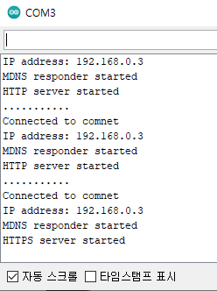
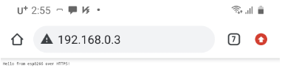
실행결과

